Slide 1
NOTES

Slide 2
Cloud computing
It provides resources to consumers in the form of different services, such as software, infrastructure, platforms, and security.
Cloud services can be broadly classified into three major types: software as a service (SaaS), platform as a service (PaaS), and infrastructure as a service (IaaS). Many other services, such as security as a service (SeaaS), knowledge as a service, and analytics as a service (AaaS) are emerging.

Slide 3
Providers of Infrastructure as a Service
Infrastructure as a service (IaaS) is a provision model in which an organization offers storage, hardware, servers, and networking components to users for their use on demand.
The client typically pays on a per‐use basis.
The service provider owns the infrastructure and is responsible for housing, running, and maintaining it.
few major IaaS providers such as Amazon and Rackspace

Slide 4
Amazon Elastic Compute Cloud
Amazon Elastic Compute Cloud (EC2) provides scalable computing capacity in the Amazon Web Services (AWS) Cloud.
Using Amazon EC2 eliminates your need to invest in hardware up front, so you can develop and deploy applications faster.
You can use Amazon EC2 to launch as many or as few virtual servers as you need, configure security and networking, and manage storage.
Amazon EC2 enables you to scale up or down to handle changes in requirements or spikes in popularity, reducing your need to forecast traffic.

Slide 5
Features of Amazon EC2
Virtual computing environments, known as instances
Preconfigured templates for your instances, known as Amazon Machine Images (AMIs), that package the bits you need for your server (including the operating system and additional software)
Various configurations of CPU, memory, storage, and networking capacity for your instances, known as instance types
Secure login information for your instances using key pairs (AWS stores the public key, and you store the private key in a secure place)
Storage volumes for temporary data that's deleted when you stop, hibernate, or terminate your instance, known as instance store volumes

Slide 6
Features of Amazon EC2
Persistent storage volumes for your data using Amazon Elastic Block Store (Amazon EBS), known as Amazon EBS volumes
Multiple physical locations for your resources, such as instances and Amazon EBS volumes, known as Regions and Availability Zones
A firewall that enables you to specify the protocols, ports, and source IP ranges that can reach your instances using security groups
Amazon EC2 enables the user to instantiate virtual machines of his choice through a Web‐service interface.
An instance can be obtained on demand on an hourly basis, thus eliminating the need for estimating computing needs in advance.
https://docs.aws.amazon.com/AWSEC2/latest/UserGuide/concepts.html

Slide 7
Features of Amazon EC2
AWS provides Amazon Cloud Watch, a Web service that provides monitoring for AWS cloud resources, starting with Amazon EC2. It enables customers to observe resource utilization, operational performance, and overall demand patterns – including metrics such as CPU utilization, disk reads and writes, and network traffic.

Slide 8
Different instance types
standard instances – suitable for most applications;
microinstances – suitable for low‐throughput applications;
high‐memory instances – suitable for high‐throughput applications;
high‐CPU instances – suitable for compute‐intensive applications;
cluster compute instances – suitable for high‐performance computing (HPC) applications.

Slide 9
Rackspace Cloud
Rackspace Cloud offers IaaS to clients. It offers three cloud computing solutions – cloud servers, cloud files, and cloud sites.
Cloud servers provide computational power on demand in minutes.
Cloud files are for elastic online file storage and content delivery
Cloud sites are for robust and scalable Web hosting.

Slide 10
Rackspace Cloud
Cloud servers is an implementation of IaaS where computing capacity is provided as virtual machines, which run in the cloud servers’ systems. The virtual machine instances are configured with different amounts of capacity.
The instances come in different flavors and images. A flavor is an available hardware configuration for a server. Each flavor has a unique combination of disk space, memory capacity, and priority for CPU time.
Virtual machines are instantiated using images. An image is a collection of files used to create or rebuild a server.
A variety of prebuilt operating system images is provided by Rackspace Cloud – 64‐bit Linux Distributions (Ubuntu, Debian, Gentoo, CentOS, Fedora, Arch and Red Hat Enterprise Linux) or Windows Images (Windows Server 2003 and Windows Server 2008). These images can be customized to the user’s choice

Slide 11
Providers of Platform as a Service
Platform as a service (PaaS) is a category of cloud computing services that provides a computing platform for development of applications.
Its offerings facilitate the deployment of applications without the cost and complexity of buying and managing the underlying hardware and software and provisioning hosting capabilities.
It may also include facilities for application design, development, testing, and deployment.
It also offers services such as Web‐service integration, security, database integration, storage, and so forth.

Slide 12
Google Cloud Platform
Google Cloud Platform enables developers to build, test and deploy applications on Google’s highly scalable and reliable infrastructure.
Google has one of the largest and most advanced networks across the globe and offers software infrastructure such as MapReduce, BigTable, and Dremel.
Google Cloud Platform includes virtual machines, block storage, NoSQL datastore, big data Analytics, and so forth.
It provides a range of storage services that allows easy maintenance and quick access to users’ data.
Cloud Platform offers a fully managed platform as well as flexible virtual machines allowing users to choose according to their requirements.
Google also provides easy integration of the user’s application within Cloud Platform
Managed services such as App Engine or Cloud Datastore provide autoscaling, which enables the application to grow with the users. The user has to pay only for what he uses

Slide 13
Google App Engine
Google App Engine lets the user run Web applications on Google’s infrastructure. App Engine applications are easy to build, easy to maintain, and easy to scale as traffic and data storage needs grow.
There are no servers to maintain App Engine. App can be served from the user’s own domain name (such as http://www.example.com/) using Google Apps.
Otherwise it can be served using a free name on the appspot.com domain. An application can be shared with the world, or it can limit access to members of organization.

Slide 14
Google App Engine
Google App Engine supports apps written in several programming languages.
Apps can be built using standard Java technologies, including the JVM, Java servlets, and the Java programming language, JavaScript or Ruby, Python, or PHP—or bring your own language runtime.
A fully managed environment lets you focus on code while App Engine manages infrastructure concerns.
Use Cloud Monitoring and Cloud Logging to monitor the health and performance of your app and Cloud Debugger and Error Reporting to diagnose and fix bugs quickly.
Easily host different versions of your app, and easily create development, test, staging, and production environments.

Slide 15
SAP HANA Cloud Platform
The SAP HANA Cloud Platform is an open‐standard, Eclipse‐based, modular platform as a service.
The applications run within the Java‐based SAP HANA Cloud Platform runtime environment powered by SAP HANA, and can be maintained using Web‐based management tools.
The main features of the SAP HANA Cloud Platform are as follows:
an enterprise platform built for developers;
native integration with SAP and non‐SAP software;
in‐memory persistence;
a secure data platform

Slide 16
SAP HANA Cloud Platform
The SAP HANA Cloud Platform lets the users quickly build and deploy business and consumer applications that deliver critical new functionality to meet emerging business needs.
It also helps connecting users with customers in more engaging experiences.
Support for open programming standards provides a low barrier to entry for developers

Slide 17
Captiva Cloud Toolkit
A tool called Captiva Cloud Toolkit to assist software development is offered by EMC.
The EMC Captiva Cloud Toolkit is a software developer kit (SDK) comprised of modules that help Web application developers to add scanning and imaging functionality quickly and directly to their Web‐based business applications.
Using the Captiva Cloud Toolkit, developers can quickly create a working scan‐enabled Web‐based business application
Scan. Basically scanning happens at page level to bring images page by page into Captiva. Scanning is the entry point to Captiva where one can import any kind of document like pdf, tiff, or jpg.

Slide 18
Captiva Cloud Toolkit
IE: Image enhancement is a kind of filter or repairing tool for images that are not clear. It enhances image quality so it can be processed easily. One can configure IE in accordance with business requirements and images being received. The main functions of IE include deskewing and noise removal

Slide 19
Providers of Software as a Service
Software as a service (SaaS) is a software distribution model in which applications are hosted by a vendor or service provider and made available to customers over a network.

Slide 20
Microsoft SharePoint
Microsoft offers its own online collaboration tool called SharePoint. Microsoft SharePoint is a Web application platform that comprises a multipurpose set of Web technologies backed by a common technical infrastructure.
By default, SharePoint has a Microsoft Office‐like interface, and it is closely integrated with the Office suite.
Unlike Google Cloud Connect, Microsoft SharePoint is not a free tool but it has additional features that cannot be matched by Google or any other company.

Slide 21
Google Cloud Connect
Google Cloud Connect is a feature provided by Google Cloud by integrating cloud and API for Microsoft Office.
After installing a plug‐in for the Microsoft Office suite of programs, one can save files to the cloud.
The cloud copy of the file becomes the master document that everyone uses.
Google Cloud Connect assigns each file a unique URL, which can be shared to let others view the document.
If changes are made to the document, those changes will show up for everyone else viewing it.
When Multiple people make changes to the same section of a document, Cloud Connect gives the user a chance to choose which set of changes to keep.

Slide 22
Google Cloud Print
Google Cloud Print is a service that extends the printer’s function to any device that can connect to the Internet.
To use Google Cloud Print, the user needs to have a free Google profile, an app program or web site that incorporates the Google Cloud Print feature, a cloud‐ready printer, or printer connected to a computer logged onto the Internet.
When Google Cloud Print is used through an app or Web site, the print request goes through the Google servers.
Google routes the request to the appropriate printer associated with the user’s Google account.
Assuming the respective printer is on and has an active Internet connection, paper and ink, the print job should execute on the machine. The printer can be shared with other people for receiving documents through Google Cloud Print.

Slide 23
Sales Cloud
Salesforce.com is a cloud computing and social enterprise SaaS provider. Of its cloud platforms and applications, the company is best known for its Salesforce customer relationship management (CRM) product.
Sales Cloud refers to the “sales” module in salesforce.com. It includes Leads, Accounts, Contacts, Contracts, Opportunities, Products, Pricebooks, Quotes, and Campaigns.
The Sales Cloud gives a platform to connect with customers from complete, up‐to‐date account information to social insights, all in one place and available anytime, anywhere.
Everything occurs automatically in real time, from contact information to deal updates and discount approvals.

Slide 24
Providers of Data Storage as a Service
Data Storage as a service (DSaaS) is another important service in the field of cloud computing. One need not buy large‐sized hard drives. Instead, one can use this service and pay rent to the company, which provides this service.
Amazon Storage as a Service
Amazon Storage as a Service known as Amazon S3 is storage for the Internet.
Amazon S3 provides a highly durable and available store for a variety of content, ranging from Web applications to media files. It allows users to offload storage where they can take advantage of scalability and pay‐as–you‐go pricing. For sharing content that is either easily reproduced or where one needs to store an original copy elsewhere, Amazon S3’s Reduced Redundancy Storage (RRS) feature provides a compelling solution. It also provides a better solution with Storage for Data Analytics

Slide 25
Google Cloud Storage
Google Cloud Storage is an Internet service to store data in Google’s cloud
The service combines the performance and scalability of Google’s cloud with advanced security and sharing capabilities.
It is safe and secure.
Data is protected through redundant storage at multiple physical locations.
It is different from Google Drive as Google Drive is for users whereas Google Cloud Storage is for developers.

Slide 26
IBM SmartCloud
IBM SmartCloud is a branded ecosystem of cloud computing products and solutions from IBM.
It include IaaS, PaaS, and SaaS offered through public, private, and hybrid cloud delivery models.
IBM places these offerings under three umbrellas: SmartCloud Foundation, SmartCloud Services, and SmartCloud Solutions.
SmartCloud Foundation consists of the infrastructure, hardware, provisioning, management, integration, and security that serve as the underpinnings of a private or hybrid cloud

Slide 27
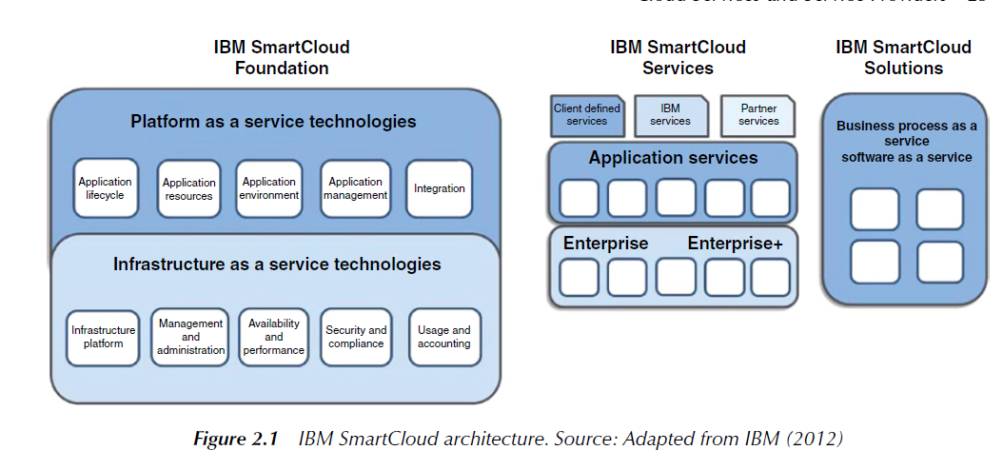

Slide 28
Thank you

